Slide 1
Data Science Salary Prediction
Amira Bendjama, Anh Nguyen, Hong Doan

Slide 2
BUSINESS PROBLEM: Salary Transparency
Data Science has experienced remarkable growth in recent years with employment rate estimated to grow by 36% from 2021 to 2031, which is higher than the average growth rate of 5% (US Bureau of Labor Statistics)
Job seekers are facing challenge due to the lack of salary transparency in the DS job market
The discrepancies in data science salaries can also be attributed to various factors, including industries, locations, job responsibilities, experience level, educational background, and specific skill sets.
Only 17% of companies are disclosing pay range information in U.S. locations where not required by state or local laws (Survey by WTW)
Notes:
: Your overall goals and objectives for the projects and your (research) questions.

Slide 3
PROJECT GOALS
Predicting the salary range for data science jobs using multiclass classification models
By leveraging publicly available data and employing machine learning algorithms, we seek to provide job seekers a better understanding of salary expectations within the data science job market and empower them to negotiate fair and competitive compensation packages.
Notes:
: Your overall goals and objectives for the projects and your (research) questions.

Slide 4
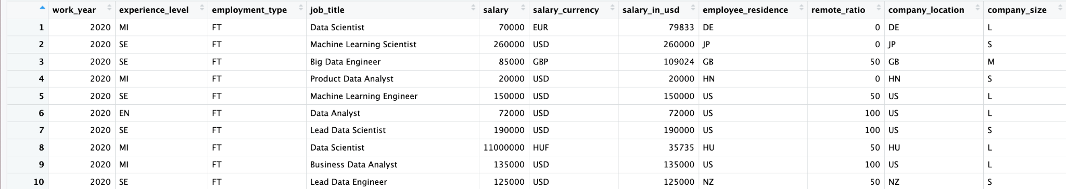
DATA SOURCE
Combined two different datasets from 2020 to 2023 which are available on Kaggle, with 4362 observations.
The dataset is aggregated from the website ‘ai-jobs.net.’
Dataset contains 11 columns : work_year, experience_level, employment_type, job_title, salary, salary_currency, salary_in_usd, employee_residence, remote_ratio, company_location, and company_size.
Notes:
: Your overall goals and objectives for the projects and your (research) questions.

Slide 5
DATA PREPARATION
Drop unused columns (salary_currency and salary) as we want to focus on "USD" currency so we only retain the "salary_in_usd" column
Remove duplicated rows
Adding new column to split our salaries into three groups Low , High, Medium using percentiles
Notes:
Data sources, original formats, what is in the data, relevant variables and details. The steps you have taken to prepare and/or convert data for the proposed analytics.

Slide 6
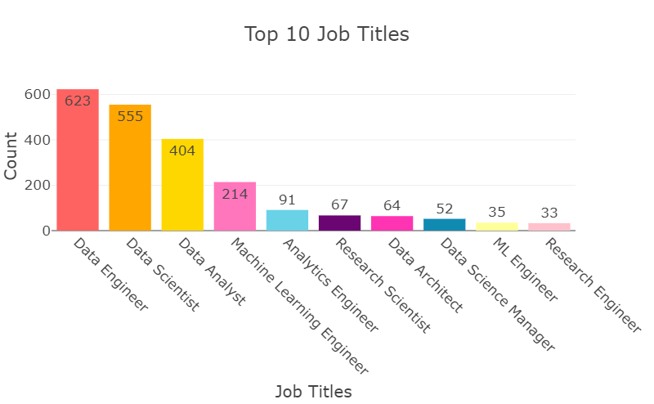
DATA EXPLORATION
The job title category distribution is imbalanced with almost 74% of the data are under the top 3 job titles (data engineer, data scientist and data analyst).
Notes:
The processes in which you explore, visualize, cleanse, and transform data for the project.

Slide 7
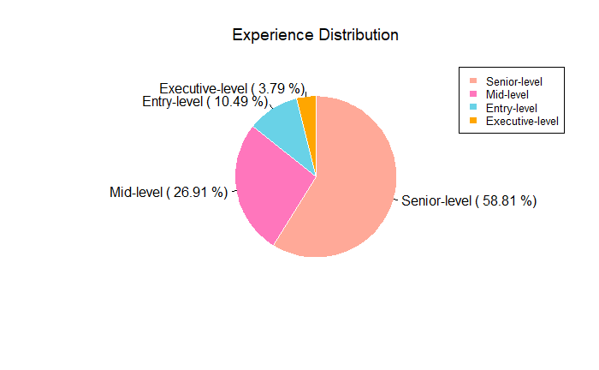
DATA EXPLORATION (CONT)
Senior-level category accounts for almost 59% of our data, followed by mid-level (27%) and entry-level (10%). The distribution of experience category is imbalanced.

Slide 8
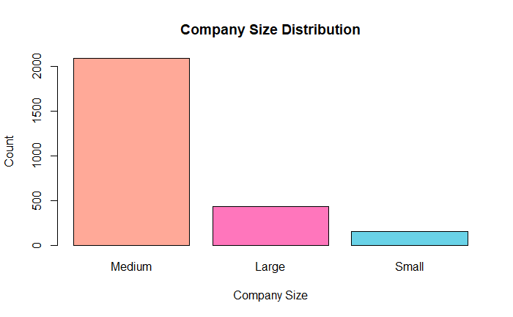
DATA EXPLORATION (CONT)
The company size category distribution is imbalanced with majority of the data falls under medium size.

Slide 9
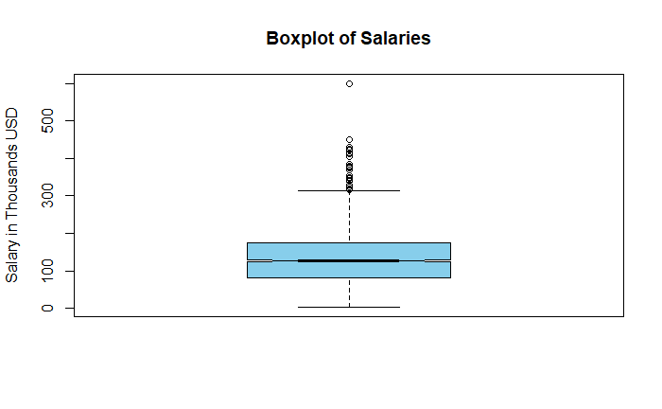
DATA EXPLORATION (CONT)
For the salary attribute, the median value is a little above $100,000. The min value is around $70,000. The max value is around $300,000. There are some outlines, which show salary greater than the max value. These could be the salary of the executives.

Slide 10
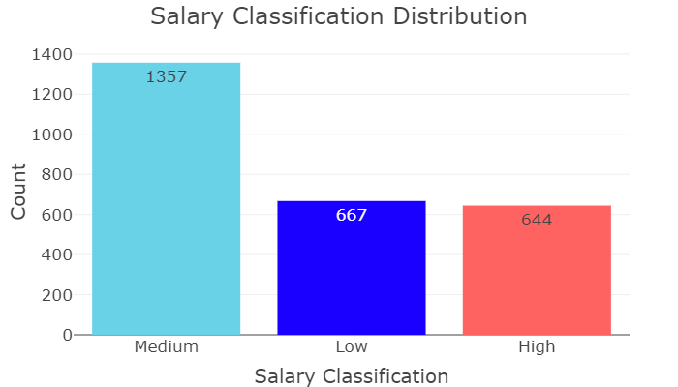
DATA EXPLORATION (CONT)
For salary classification category, the medium range accounts for approximately half of our data.

Slide 11
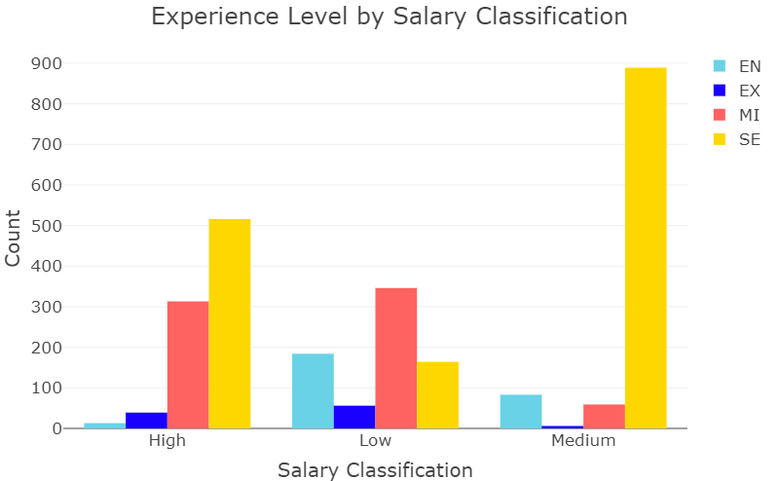
DATA EXPLORATION (CONT)
Looking at the distribution of the data by salary classification and experience level, the senior level accounts for majority of data in the medium and high salary classification, which makes sense. In the low salary classification, entry level and medium level account for the majority of data.

Slide 12
METHODOLOGY
We will use four different multiclass classification models to classify the salary range of data science jobs:
Logistic Regression
SVM
Random Forest
Decision Tree
Notes:
How you approach the problem and analysis, why you select the models/methods, and details of related models.

Slide 13
Feature engineering
Updates 'company_location' and 'employee_residence' variables to either "US" or "Other", to make more balanced columns
Update Job titles to 4 categories instead of 95, which are “Data Analyst”, “Data Engineer”, “Data Scientist”, “Other”, to simplify and generalize the job
Handle the categorical columns, the "Factor()" function has been used.
Features : "work_year", "experience_level", "employment_type" ,"job_title", "employee_residence" "remote_ratio", "company_location", and "company_size".
Target : salary classification (Low, Medium, High)
Notes:
How you approach the problem and analysis, why you select the models/methods, and details of related models.

Slide 14
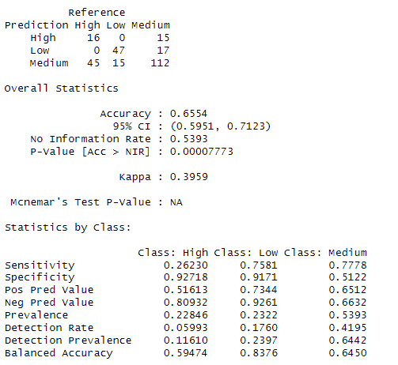
Logistic Regression Model
Logistic regression model achieved an accuracy of approximately 65.54%
it performs relatively better in predicting the "Low" and "Medium" salary classes compared to the "High" class.

Slide 15
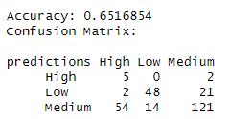
Support Vector Machine Model
The accuracy of the model is reported as 0.6516, which means that approximately 65.16% of the predictions made by the model are correct.
Based on the confusion matrix, the model seems to perform relatively well for the "Low" and "Medium" classes, with a higher number of correct predictions. However, it has more difficulty correctly predicting the "High" class, as indicated by the lower number of correct predictions compared to the other classes.

Slide 16
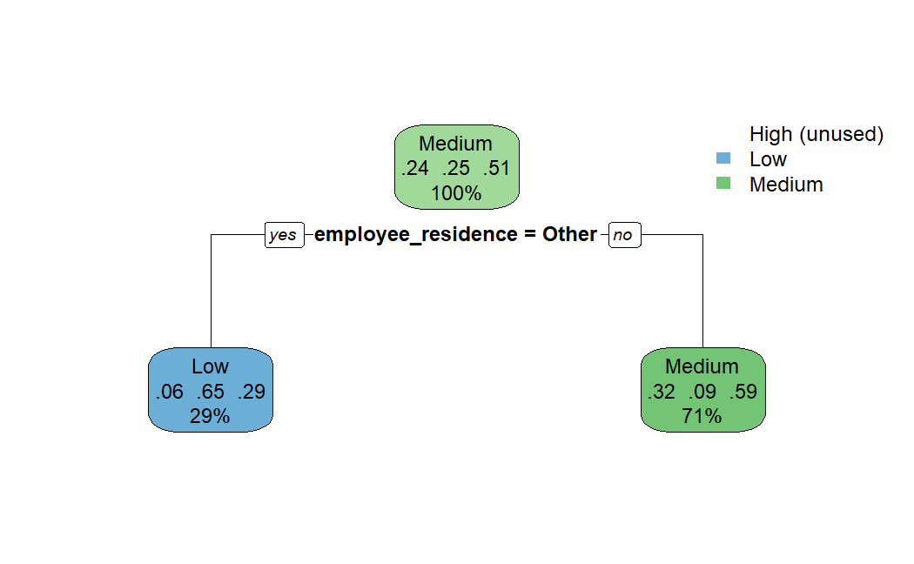
Decision Tree Model
"Accuracy: 0.64"
The "High" class is not used in this decision tree, and one of the reasons is the imbalanced data. The "High" class has a significantly smaller number of observations compared to the other classes.
Decision tree is making predictions based on the variable "employee_residence". If the value is "other", it predicts the class as "Low" with a 29% chance, and if the value is not "other", it predicts the class as "Medium" with a 71% chance
Decision tree model achieved an accuracy of 0.647.

Slide 17
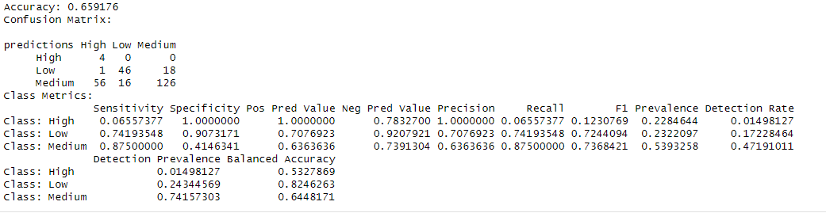
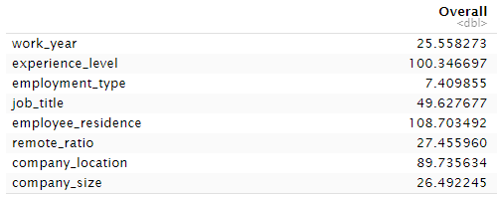
Random Forest Model
Random Forest model achieved an accuracy of approximately 65.92%
Lower performance in terms of sensitivity and precision for the "High" class
The Random Forest model highlights the importance of "experience_level" and "employee_residence" in predicting salary classification (importance values: 100.35 and 108.70, respectively).
"job_title" and "company_location" also significantly impact salary classification (importance values: 49.63 and 89.74, respectively).

Slide 18
Results discussion
Logistic regression and Random Forest models have the best performance with accuracy of 66%
SVM model has accuracy of 65% and Decision Tree model has accuracy of 64%
Notes:
How you interpret the results, what evaluation metrics you use, what you find and learn from result evaluation.

Slide 19
Limitations and challenges
Missing important features: such as educational background, years of experience, or industry sector
Not up-to-date dataset : salaries changes over time
Geographic Bias : mostly include data from United states
Dataset features are imbalance which explains the accuracy results
Class imbalance: it might explain the lower predictions for “High” class
Job titles generalization for the feature engineering

Slide 20
FUTURE WORK
Continuous data updating: Update the dataset with the most recent salary information by scraping salary data and incorporating additional features such as degree level and certifications from reliable sources or leveraging APIs. This will ensure that the dataset reflects current salary trends and provide a deeper insight into the determinants of salaries.
Migrate geographic bias by expand the data collection to include the data from a wide range of locations, not just limited to the U.S.
Explore advanced modeling techniques: such as neural network and ensemble methods to handle class imbalance.

